Slide 1


SALES ANALYSIS
- In Excel

Slide 2
OVERVIEW
To conduct a comprehensive analysis of Blinkit’s sales performance to identify key insights and opportunities for optimization using various KPIs and visualizations in Excel.
KPI Requirements
Total Sales – The overall revenue generated from all items sold.
Average Sales – The average revenue per sale.
Number of Items – The total count of different items sold.
Average Rating – The average customer rating for items sold.

Slide 3
BUSINESS REQUIREMENTS
1. TOTAL SALES BY FAT CONTENT
Objective:
Analyze the impact of fat content on total sales.
Additional KPI Metrics:
Assess how other KPIs (Average Sales, Number of Items, Average Rating) vary with fat content.
Chart Type:
Donut Chart.

Slide 4
BUSINESS REQUIREMENTS
2. TOTAL SALES BY ITEM TYPE
Objective:
Identify the performance of different item types in terms of total sales.
Additional KPI Metrics:
Assess how other KPIs (Average Sales, Number of Items, Average Rating) vary with item type.
Chart Type:
Bar Chart.

Slide 5
BUSINESS REQUIREMENTS
3. FAT CONTENT BY OUTLET FOR TOTAL SALES
Objective:
Compare total sales across different outlets segmented by fat content.
Additional KPI Metrics:
Assess how other KPIs (Average Sales, Number of Items, Average Rating) vary with fat content.
Chart Type:
Stacked Bar Chart.

Slide 6
BUSINESS REQUIREMENTS
4. TOTAL SALES BY OUTLET ESTABLISHMENT
Objective:
Evaluate how the age or type of outlet establishment influences total sales.
Chart Type:
Line Chart.

Slide 7
BUSINESS REQUIREMENTS
5. SALES BY OUTLET SIZE
Objective:
Analyze the correlation between outlet size
and total sales.
Additional KPI Metrics:
Assess how other KPIs (Average Sales, Number
of Items, Average Rating) vary with fat content.
Chart Type:
Donut Chart.

Slide 8
BUSINESS REQUIREMENTS
6. SALES BY OUTLET LOCATION
Objective:
Assess the geographic distribution of sales across different locations.
Chart Type:
Bar Chart.

Slide 9
BUSINESS REQUIREMENTS
7. ALL METRICES BY OUTLET TYPE
Objective:
Provide a comprehensive view of all key metrics.
Chart Type:
Matrix Card.

Slide 10
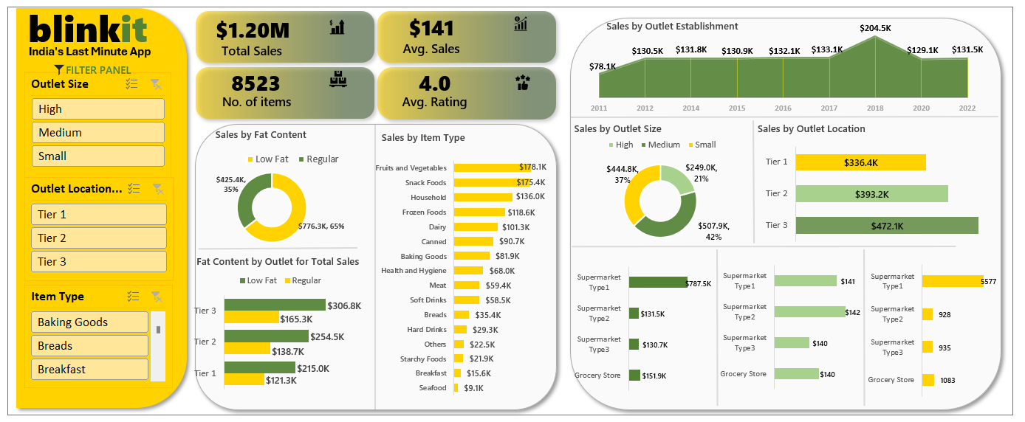
EXCEL DASHBOARD

